Slide 1

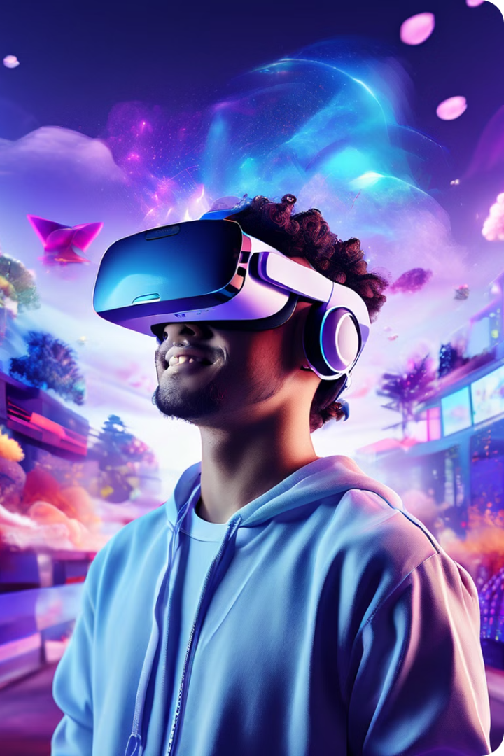

Introduction to Virtual Reality
Virtual reality (VR) immerses users in computer-generated environments. It utilizes hardware and software to create a simulated sensory experience. VR applications have various uses, from gaming and entertainment to education and training.
Vincent njagi

Slide 2
Components of Virtual Reality
Hardware
Software
The hardware of a VR system consists of a head-mounted display (HMD), motion tracking sensors, controllers, and haptic feedback devices. These components work together to create an immersive and interactive experience.
VR software creates the virtual worlds, experiences, and interactions. It includes game engines, development tools, and applications designed for VR platforms. Software is essential for creating compelling VR content.

Slide 3
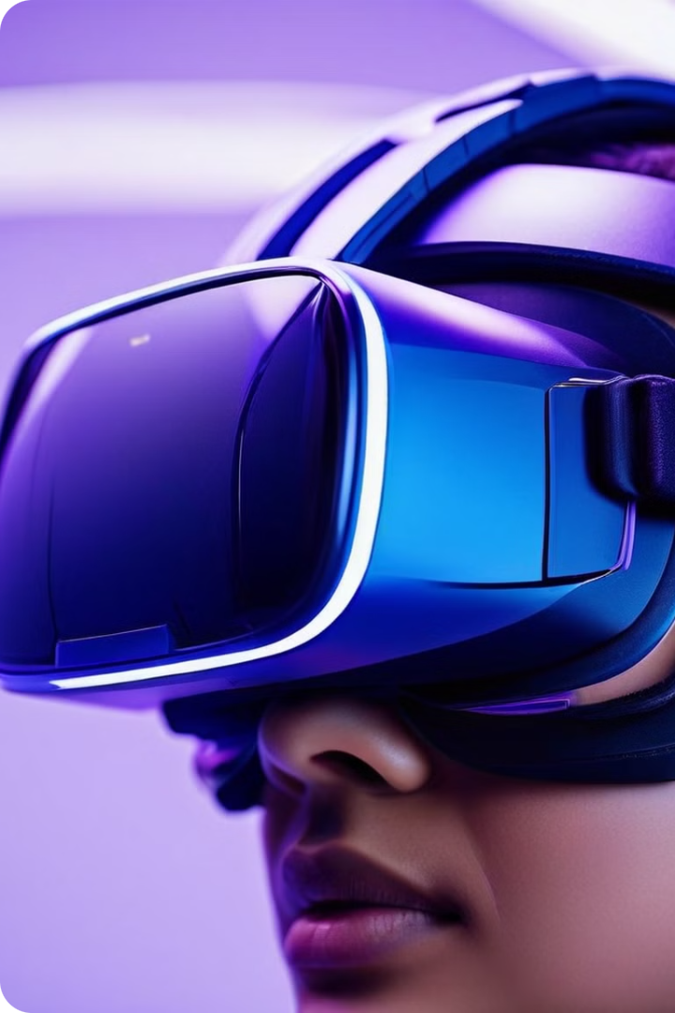
Head-Mounted Displays (HMDs)
1
Displays
2
Sensors
HMDs are equipped with high-resolution displays that provide users with a wide field of view, creating a sense of immersion and presence in the virtual environment.
HMDs include motion sensors like gyroscopes and accelerometers to track the user's head movements and update the virtual world in real time.
3
Lenses
The lenses in HMDs focus the images from the displays to create a realistic and comfortable viewing experience. They allow for precise control of focus and distortion.

Slide 4




Motion Tracking Sensors
Positional Tracking
Motion tracking sensors determine the user's location and orientation in space. They provide data to the VR software, which updates the virtual environment accordingly.
External Sensors
External sensors like cameras or lasers are used to track the position and movement of the user's body, controllers, and other objects in the VR environment.
Internal Sensors
HMDs and controllers often have internal sensors like accelerometers and gyroscopes to track movement and orientation in a more localized manner.

Slide 5



Haptic Feedback Devices
Vibrations
Force Feedback
Haptic feedback devices provide tactile sensations, like vibrations or pressure, to simulate the feeling of touching or interacting with virtual objects.
Force feedback devices, such as haptic suits or gloves, create realistic resistance and forces when interacting with virtual objects, making the experience more immersive.

Slide 6

Interaction Controllers
Type
Description
Handheld Controllers
These are small, handheld devices that allow users to interact with the virtual environment through buttons, joysticks, and motion sensors.
Gloves
Gloves with sensors and actuators provide more detailed hand tracking and haptic feedback, allowing for more natural and precise interactions.
Foot Pedals
Foot pedals can be used to control movement, actions, or specific functions in the virtual world, adding another layer of interaction.

Slide 7

VR Software and Applications
Games
Training Simulators
VR games offer immersive experiences, allowing players to feel like they are physically present in the game world. They can range from action-packed adventures to puzzle-solving challenges.
VR simulators are used to train professionals in various fields, including medicine, engineering, and aviation, by providing safe and realistic simulations of real-world scenarios.
Social Experiences
VR social experiences enable users to connect and interact with others in virtual worlds, allowing for virtual gatherings, events, and even collaborative activities.

Slide 8

Future Trends and Developments in VR
1
Improved Hardware
Advancements in display technology, sensors, and haptic feedback devices are constantly improving the quality and realism of VR experiences.
2
AI Integration
Artificial intelligence is playing a bigger role in VR, creating more intelligent and responsive virtual environments and characters.
3
Immersive Content
VR content is becoming more sophisticated, with greater emphasis on story, gameplay, and social interaction.
4
Accessibility and Affordability
VR technology is becoming more accessible and affordable, making it available to a wider range of users.

